Slide 1

NLP
Group 1:
Happy
Nicholai
Goal: to build a classifier that is able to distinguish between ‘real’ and ‘fake’ news..

Slide 2

Two main approaches
Classic ML
Deep Learning
Minimal to no preprocessing for BERT
Use of a pre-trained BERT model: jy46604790/Fake-News-Bert-Detect
Loaded via Hugging Face’s pipeline
Batched inference for efficiency
Approach & Methodology

Slide 3
Approach and Methodology (Other models )
Cleaning Steps:
Convert to lowercase
Remove punctuation
Remove numbers
Strip whitespace
Combined Columns:
title + text = cleaned
Tool Used:
TfidfVectorizer with English stop words removed
Model | Type | Strengths | Notes
Logistic Regression | Linear | Simple, interpretable | Good baseline
Naive Bayes | Probabilistic | Fast, works well on text | Assumes feature independence
Random Forest | Ensemble | Reduces overfitting, robust | Slower, more complex
XGBoost | Boosting | High performance, regularized | Requires tuning

Slide 4
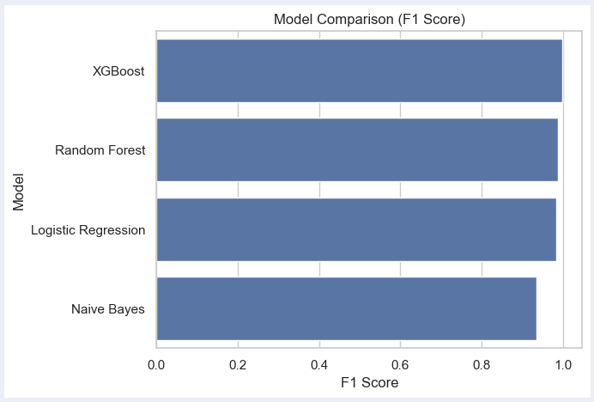
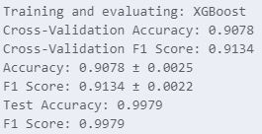
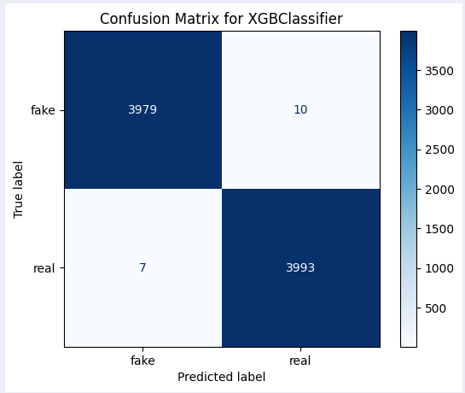
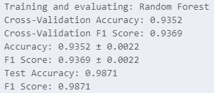
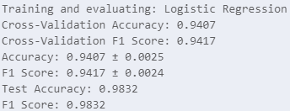
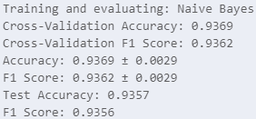
Scores (Other models)

Slide 5
BERT
Stands for Bidirectional Encoder Representations from Transformers
Pretrained on massive datasets
Little to no pre-processing
Reads entire text in both directions—understands context, not just keywords
Outperforms classic ML
Limitations
Generalization to new types of fake news
Computational cost

Slide 6

Leading open-source platform for Natural Language Processing (NLP)
A library that provides access to thousands of pretrained models
jy46604790/Fake-News-Bert-Detect (pre-trained model)
This particular model is trained by over 40,000 news sources from different media based on the 'roberta-base'.
Hugging Face

Slide 7
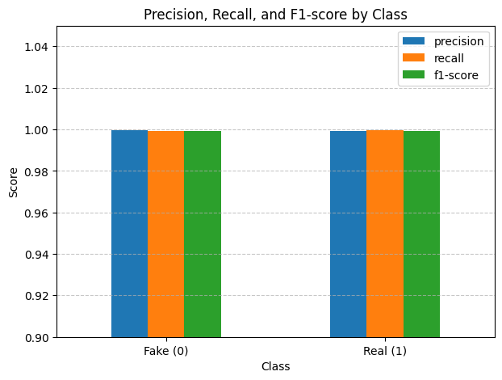
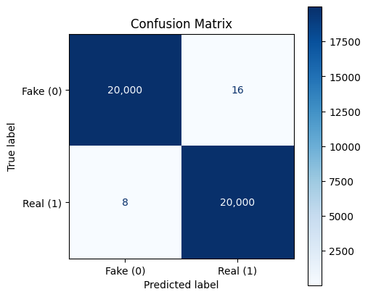
Results (BERT)
✅ Accuracy: 0.9993991287366681

Slide 8
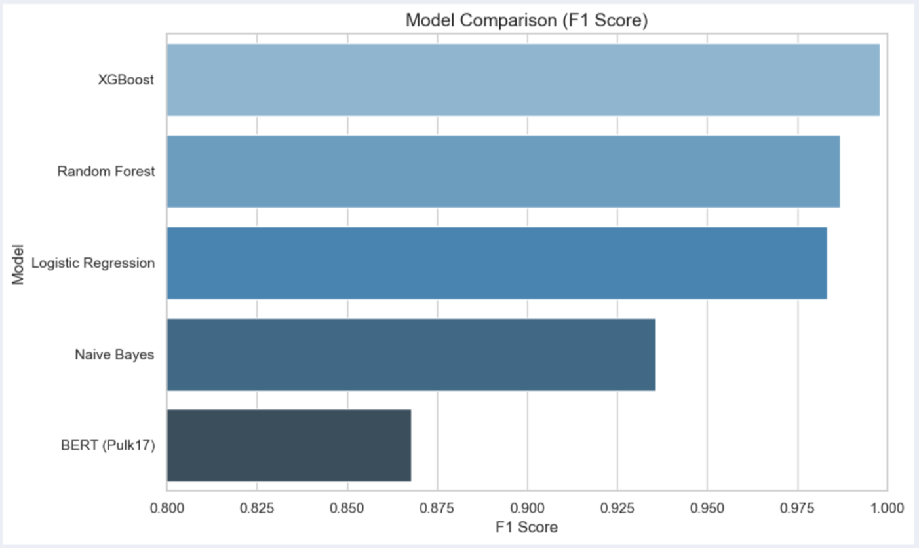
Scores (Other models + BERT Pulk17)

Slide 9
The opportunity to explore deep learning and the Hugging Face ecosystem has been the most valuable outcome of this project for our team.
The worst has yet to present itself
Discussion

